Slide 1

CAN WE PREDICT UNIVERSITY PERFORMANCE?
Patricia Zapata Blanco
Ironhack - Data analysis final project

Slide 2






Table of Content
INTRODUCTION
DATA CONTEXT
MODELING
CONCLUSIONS
NEXT STEPS

Slide 3
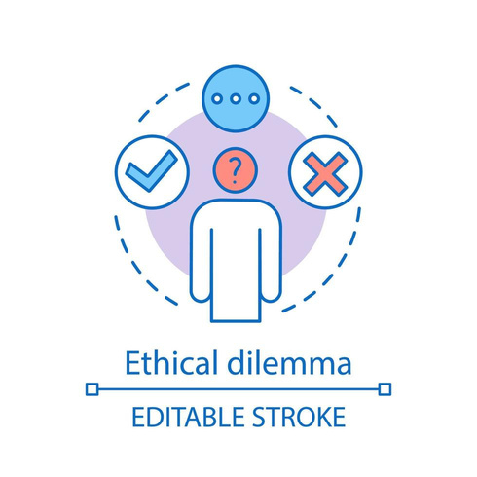


Introduction
Education
Data

Slide 4



Data context
Source: Engineering University
2014 - 2023
Pre-registrations
Students demographics / Previous education information / University access information
Students enrolled
Identification / degrees
Students grades
Subject / Numeric grade / Alpha grade

Slide 5
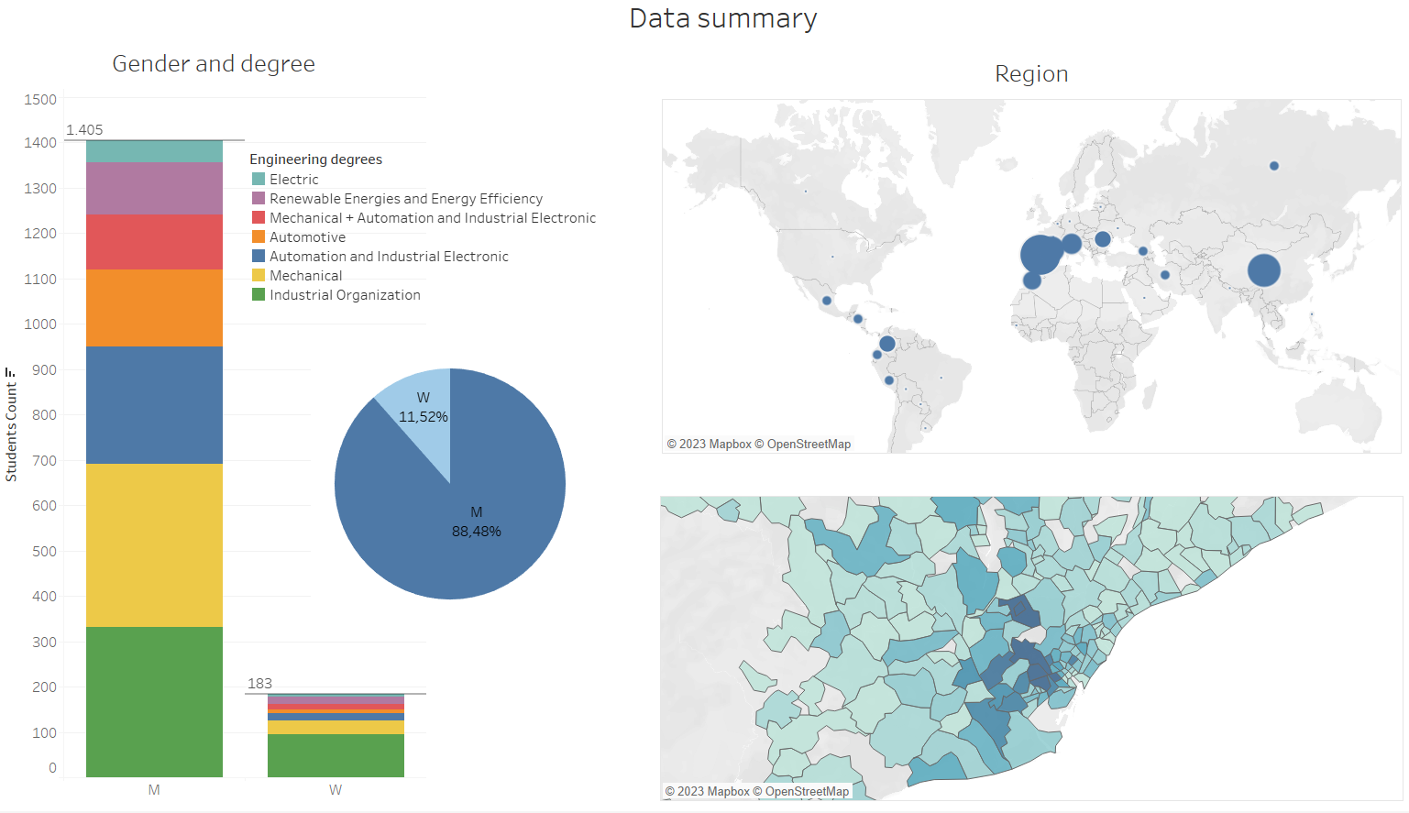


Slide 6
Parents studies / occupation
Average disposable income
Age
If the student has a job
Gender
What will predict better the Calculus grade?
Morning / Evening cohort
Grade in Selectividad
Previous
education
Reason of degree election
Order of assignation
Type of secondary school
Selectividad in June / September

Slide 7
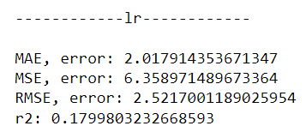
well... maybe none of this variables
Predicting numeric grade

Slide 8
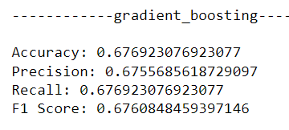
well... maybe none of this variables
or a combination of many
Predicting numeric grade
Predicting alpha grade

Slide 9

well... maybe none of this variables
or a combination of many
Predicting numeric grade
Predicting alpha grade
“Selectividad grade” is the variable
that has more importance in both models

Slide 10
Insights
Previous education and family environment do not have a big impact once you have entered
a specific university. Small correlation with grades.
It is possible to find differences across groups when comparing the means average. This might lead to have biased thoughts on certain groups. However, they might not be statistical significant.
Real data is hard to work with. Exceptions and special cases are the norm.
It is important to keep in mind the “human” aspect when working with data.

Slide 11

Next steps
1
MODEL ENHANCEMENT
Boost model performance by expanding data, addressing imbalances, and refining through trial and error.
2
CHANGE TARGET VARIABLES
Predicting performance in other subjects, or the chance of a student dropping out or of repeating a subject more than 2 times.
3
INCLUDE QUALITATIVE ANALYSIS
Once the data talks, listen to students and teachers and get insights ensuring proposed actions benefit everyone involved.

Slide 12




Thank you!
Let’s connect
+34 653091961
patriciazapatablanco@gmail.com
https://www.linkedin.com/in/patricia-zapata-blanco/

